Slide 1
Impact of Social Media on Indian General Elections

Slide 2
Table of contents
02
03
04
06
01
Abstract
Intoduction
Motivation
Information
05
07
08
Methodology
Data Pre-Processing
Survey Respondents
Data Collections Details
09
10
11
Analysis and Details
Recommendation
Furthermore

Slide 3
ABSTRACT
Social Media
Influence
Indian Elections
Cast of Votes
Supervised Learning
Impact

Slide 4
INTRODUCTION
With Social Media penetration expanding widely, its power has increased and is being used to influence something as important as elections as well.
Political parties are using the positive side of social media to their advantage.
Unfortunately, the power of this tool is something that cannot be measured nor can be handled properly.
In 2008, Barack Obama harnessed social media to rally majority of voters to win his first presidential campaign.

Slide 5
MOTIVATION OF STUDY
Challenges faced by political parties to merge with social media.
The interest generation of public on social media about election topics.
Social media has influenced almost all of the traditional aspects, but how does its affects something as important and strong as elections in India

Slide 6
Methodology
Identification of
Key Aspects
Formulation of the Questionnaire
Population of Quantitative Data through Survey
Analysis and Interpretation of populated responses
Recommendations

Slide 7
IDENTIFICAT-ION OF VARIABLES
RESEARCH QUESTION
PROBLEM STATEMENT
1. What effect do social media have on Indian General Elections?
2. How do social media influence the decision making of a voter?
3. Does social media campaign have greater impact on the voter’s decision making compared to traditional campaign?
Impact of Social Media on Indian General Elections
Independent Variable
Social Media
Dependent Variable
Elections
Our aim is to understand the how strongly votes are being affected by social media.

Slide 8
Data Pre-processing
The following are the preprocessing tasks carried out for analyzing the data :
Data was separated based on different social media as opted by the respondents and aggregated region wise.
Duration spent on social media, is further analyzed and categorized as follows :
- >30 mins – 2 hours – Max 120 mins ( Category – 1)
-> 2 hours – 3 hours – Max 180 mins ( Category – 2)
-> More than 3 hours – More than 180 mins ( Category – 3)
3. Use of social media in different regions.

Slide 9
Survey Respondents
Age | 18-30 | 31-50 | 51-80 | >80
% of Responses | 52.5% | 35.6% | 10.2% | 1.7%
The survey contains Reponses of 118 Indian citizens.
Region | North | South | West | East
% of Responses | 31.4% | 39% | 10.2% | 19.5%
Gender | Male | Female | Prefer Not to say
% of Responses | 53.1% | 44.9% | 2%

Slide 10
Data Collection Details
In the research conducted, the Target Respondents were Indians both Residentials and Non-Residentials who are eligible for voting in the Indian general elections.
The study was done by using a combination of two types of Non-Probability based sampling - Quota Sampling and Convenience Sampling.
The survey was circulated among the targeted audience and were able to gain valuable insights.

Slide 11
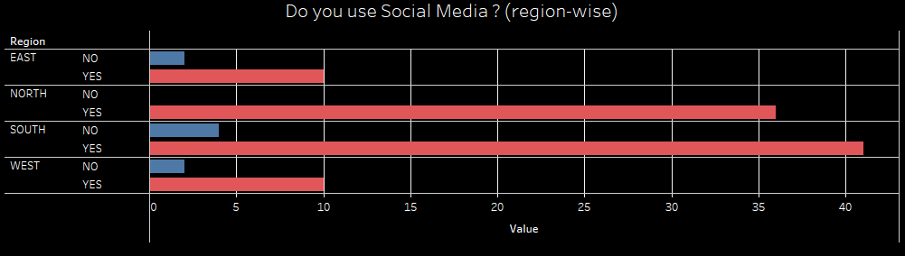

Analysis and Result
Social Media Usage Region wise

Slide 12
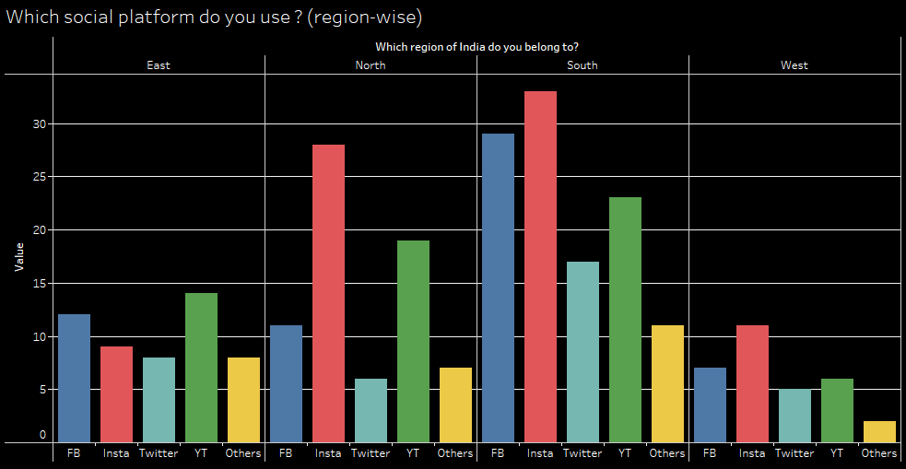
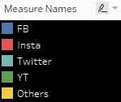
Analysis and Result

Slide 13
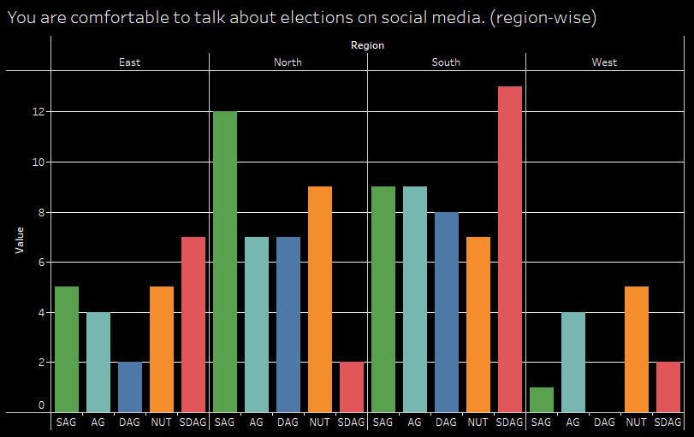
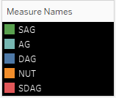
Analysis and Result

Slide 14
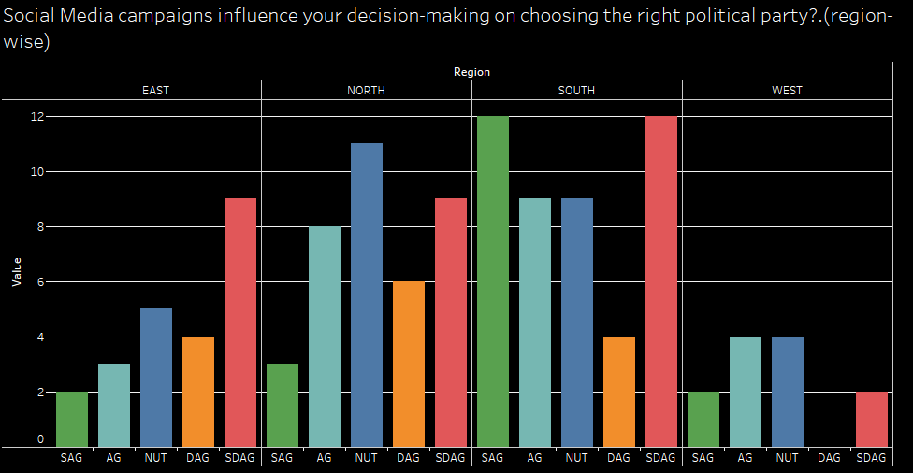
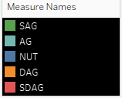
Analysis and Result

Slide 15
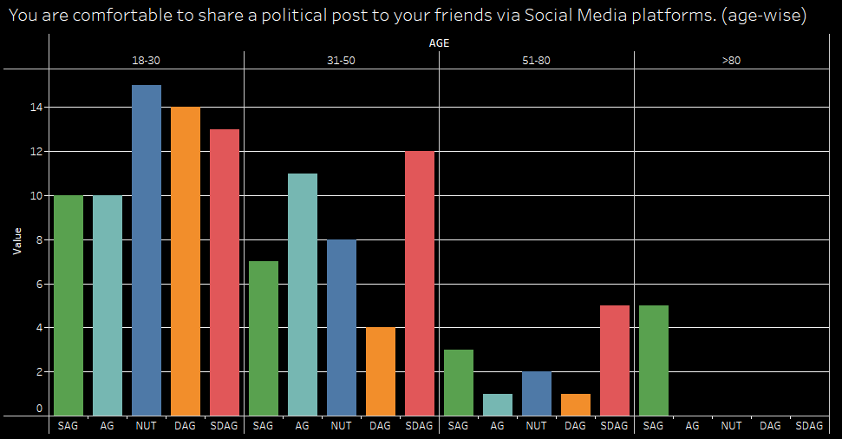
Analysis and Result

Slide 16
Recommendation
Identify widely used social media platforms region wise to tap the trending political news for a controlled approach.
Use the popular social media platforms to educate and create awareness among the public to handle its influence specific to political activities.
The Indian election commission can come up with guidelines to be practiced by the electoral candidates for a controlled social media influence.

Slide 17


Thank You
Presentation By –
Sandhra Sara
Nuha Hair
Zulaika Ali
Navnee Sharma

